Slide 1
Budget and Setup
Notes:
This is the sixth presentation in the 18-part series for CWB training. The following slides cover how to determine and setup the budget for bonus funding.

Slide 2
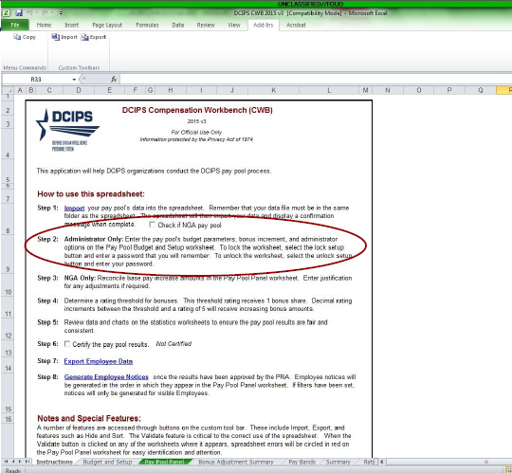
Budget and Setup
Notes:
Step 2 gives Administrators guidance to Pay Pool Administrators

Slide 3
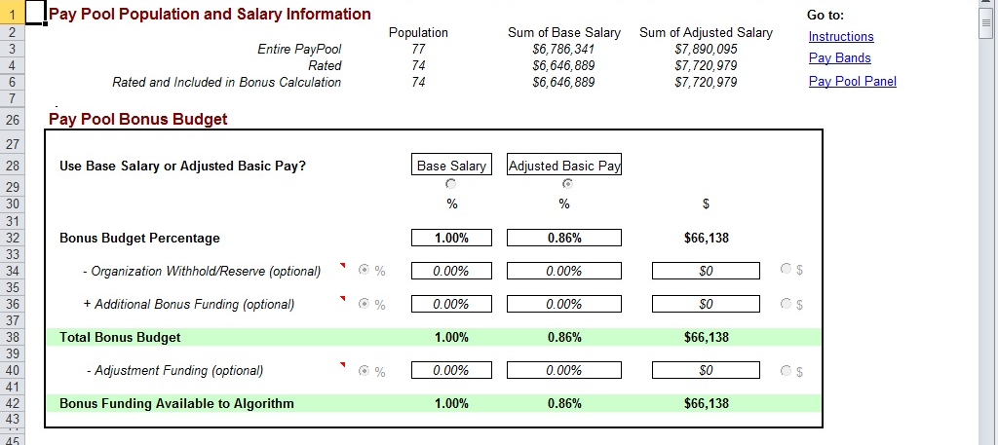
Budget and Setup
Notes:
This slide gives an example of a locked budget and setup page.

Slide 4
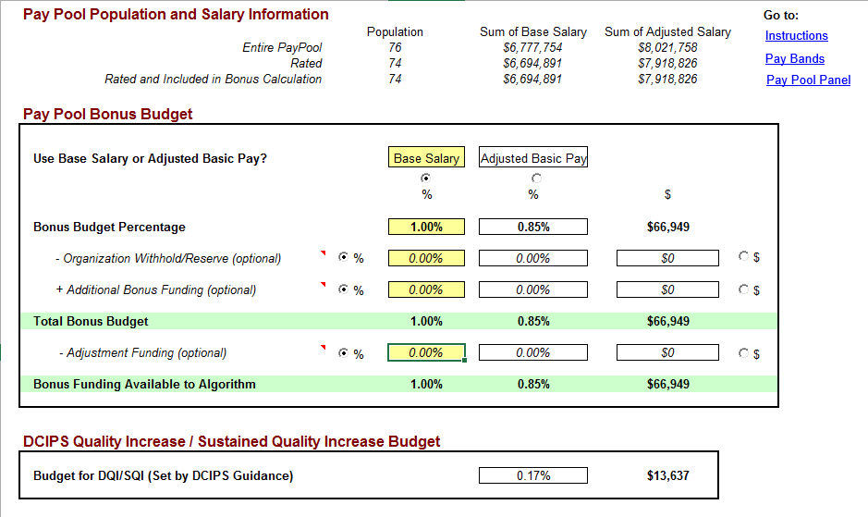
Budget and Setup
Main Salary/Bonus funding % are of total base salary (rated employees only)
Organizational Withhold/Reserve are funds removed from the pay pool budget
Entered as a dollar amount or percentage of main budget
Additional funding are funds added to the budget
Entered as a dollar amount or percentage of main budget
Adjustment funding are funds reserved for adjustments
Entered as a dollar amount or percentage of Total budget
Notes:
Pay Pool Administrators check to ensure the Main Salary/Bonus funding percentages are correct, enter the percentage or dollar amount of any funds they want to withhold for awards, annotate additional funding, and set aside funds to cover any adjustments that may be needed during the CWB process. Adjustment funding can be adjusted later in the CWB deliberating process, if necessary.
DQI/SQI percentage is automatically set at 17%. This budget is separate from the bonus funding amount and can only be used for DQI’s and SQI’s.

Slide 5
Budget and Setup (cont)
Bonus Setup
Maximum bonus
Share increment (used in the Bonus algorithm)
Floor Increase
Set by DoD
Update Floor button provides capability to update floor, pay bands, and LMS rates
Notes:
Any bonus amount above $25,000 must be approved by the President.
Floor Update applies mostly to NGA, who gives salary increases, as well as bonuses during their Pay Pool Panel process. The new floor amount is usually unavailable until the end of the year, after CWBs are deliberated and approved.

Slide 6
To continue CWB training, view next presentation
“Administrator Options”
Notes:
This concludes the sixth presentation in the 18-part series for CWB training. To continue training, view the next Presentation, entitled Administrator Options.

